Slide 1
Introduction to SAP & FI/CO
Notes:
Explain the lesson coverage

Slide 2
Lesson Objectives
After completing this lesson, participants will be able to -
Know the meaning of ERP
Introduction to SAP
SAP Landscape
Understand the R/3 system
Understand the Basics of SAP
Overview of SAP FI Module
Sub-Modules of SAP FICO

Slide 3
Introduction to ERP
What is ERP?
E – Enterprise R – Resource P – Planning
Definition:
An integrated information system that serves all departments within an
enterprise.
ERP is a way to integrate the data and processes of an Organization into
one single system.
Software solution that addresses the enterprise needs taking the process
View of an organizational goals tightly integrating all functions of an enterprise

Slide 4
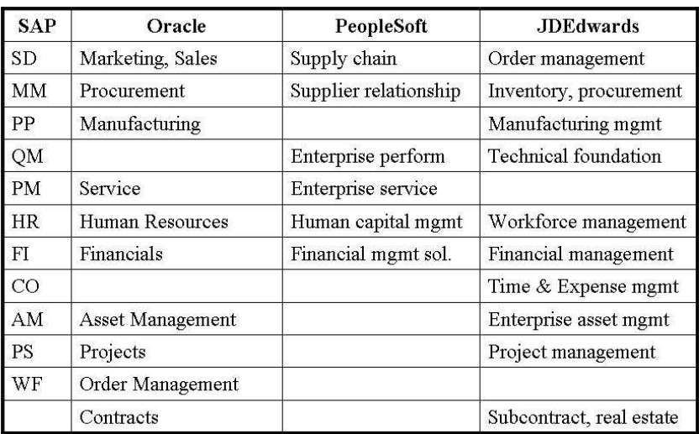
Introduction to ERP

Slide 5


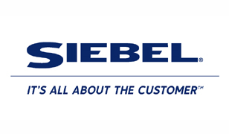
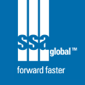
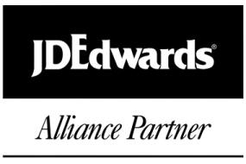

ERP Vendors

Slide 6
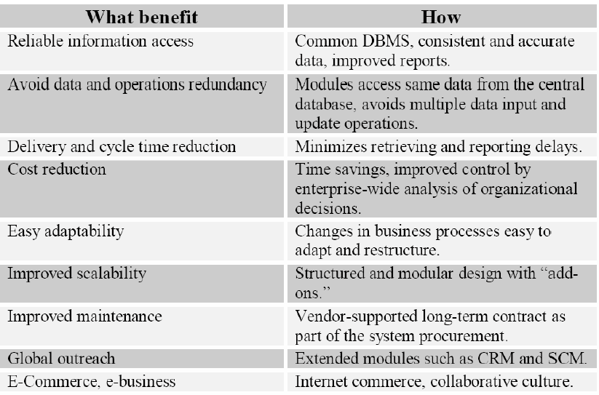
Introduction to ERP

Slide 7
ERP Overview
Is a high-end sophisticated software solution that reduces the pressure and workload of the managers
Provides accurate, timely information for taking appropriate business decisions.
Managers with knowledge of ERP will be able to achieve their targets and goals by proper implementation of ERP system in their organization.
In fact managers are expected to translate the business rules and requirements for mapping them into ERP software.
Implementation of ERP solutions is one of the largest drivers of growth in the consultancy business.
ERP automates the tasks involved in performing a business process.

Slide 8
ERP Extension
Web Enable
Customer Relationship Management (CRM)
Supply Chain Management (SCM)
Strategic Enterprise Management (SEM)
Business Information Warehouse (BIW)
Knowledge Management (KM)
So on …

Slide 9
ERP Functional Systems
Typically contained within a department
Islands of automation
Applications independently developed and deployed
Driving force: availability of mini-computers
Applications:
Human resources System
Accounting and finance systems
Sales and marketing System
Operations management System
Manufacturing Systems

Slide 10
ERP Functional Systems
Human resources System:
Recruiting
Compensation
Assessment
Development and Training
Planning
Accounting and finance systems:
General Ledger
Financial Reporting
Costing
Budgeting
Accounts Payable
Accounts receivables

Slide 11
ERP Functional Systems
Sales and marketing System:
Lead tracking
Sales forecasting
Customer management
Operations management System:
Order management
Inventory management
Customer service
Manufacturing Systems:
Inventory
Planning

Slide 12
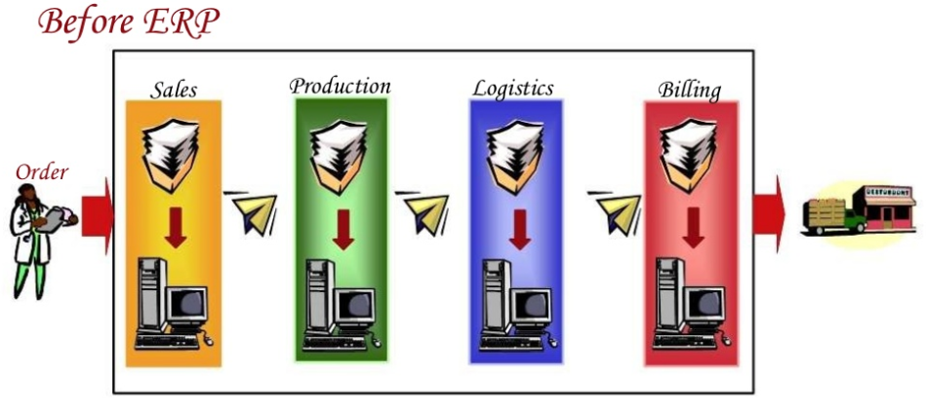
ERP Functional Systems
Problems :Delays, Lost orders, Keying into different computer systems invites errors

Slide 13
Problems with function based application
Sharing of data between systems
Data duplication
Data inconsistency
Applications that don’t talk to one another
Limited or lack of integrated information
Isolated decisions lead to overall inefficiencies
Increased expenses

Slide 14
Problems with function based application
Sharing of data between systems
Data duplication
Data inconsistency
Applications that don’t talk to one another
Limited or lack of integrated information
Isolated decisions lead to overall inefficiencies
Increased expenses

Slide 15
Order fulfillment with ERP
Helps integrate management, staff, and equipment, combining all aspects of the business into one system.
Facilitates every element of the manufacturing process.
Groups traditional company and management functions (such as accounting, human resources [HR], manufacturing management, and customer relationship management [CRM]) into a coherent whole.
Manufacturing management also includes inventory, purchasing, and quality and sales management.
Today’s leading ERP systems group all traditional company management functions (finance, sales, manufacturing, and human resources).
Many systems include with varying degrees of acceptance and skill, solutions that were formerly considered peripheral product data management (PDM), warehouse management, manufacturing execution system (MES), and reporting.

Slide 16
Order fulfillment with ERP
During the last few years the functional perimeter of ERP systems began an expansion into its adjacent markets.
For example, supply chain management (SCM), customer relationship management (CRM), business intelligence/data warehousing, and e-business.
The focus of this knowledge base is mainly on the traditional ERP realms of finance, materials planning, and human resources.
The foundation of any ERP implementation must be a proper exercise of aligning customers'' IT technology with their business strategies, and subsequent software selection.

Slide 17
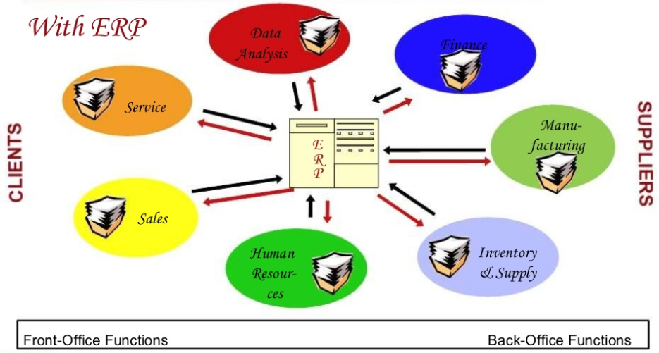
An example: Order fulfillment

Slide 18
Introduction to SAP
About SAP :
In 1972, five former IBM employees -- Dietmar Hopp, Hans-Werner Hector, Hasso Plattner, Klaus Tschira, and Claus Wellenreuther -- launch a company called Systems, Applications, and Products in Data Processing in Mannheim, Germany. Their vision: to develop standard application software for real-time business processing.
The original name for SAP was German: Systeme, Anwendungen, Produkte, and German for "Systems Applications and Products." The original SAP idea was to provide customers with the ability to interact with a common corporate database for a comprehensive range of applications. Gradually, the applications have been assembled and today many corporations, including IBM and Microsoft, are using SAP products to run their own businesses.
SAP applications, built around their latest R/3 system, provide the capability to manage financial, asset, and cost
accounting, production operations and materials, personnel, plants, and archived documents. The R/3 system runs on a number of platforms including Windows 2000 and uses the client/server model. The latest version of R/3 includes a comprehensive Internet-enabled package.

Slide 19
Introduction to SAP
The 1980s: Rapid Growth
SAP moves into the company's first building on Max-Planck-Strasse in an industrial park in Walldorf, near Heidelberg. Our software development area and its 50 terminals are all now under one roof. Fifty of the 100 largest German industrial firms are already SAP customers.
The SAP R/2 system attains the high level of stability of the previous generation of programs. Keeping in mind its multinational customers, SAP designs SAP R/2 to handle different languages and currencies. With this and other innovations in SAP R/2, SAP sees rapid growth.
By the middle of the decade, SAP founds its first sales organization outside Germany, in Austria. The company makes its first appearance at the CeBIT computer fair in Hanover, Germany. Revenues reach DM 100 million (around $52 million), earlier than expected.
In August 1988, SAP GmbH becomes SAP AG. Starting on November 4, 1.2 million shares are listed on the Frankfurt and Stuttgart stock exchanges.

Slide 20
Introduction to SAP
Germany's renowned business journal, manager magazine, names SAP its Company of the Year -- a distinction we
would receive twice more in the next few years.
With the founding of subsidiaries in Denmark, Sweden, Italy, and the United States, SAP's international expansion
takes a leap forward.
The 1990s: A New Approach to Software and Solutions
SAP R/3 is unleashed on the market. The client-server concept, uniform appearance of graphical interfaces, consistent use of relational databases, and the ability to run on computers from different vendors meets with overwhelming approval. With SAP R/3, SAP ushers in a new generation of enterprise software -- from mainframe computing to the three-tier architecture of database, application, and user interface. To this day, the client-server architecture is the standard in business software.

Slide 21
Introduction to SAP
A growing number of subsidiaries are managed out of Walldorf. The new Sales and Development Center in Walldorf officially opens it doors. It symbolizes the global success of the company. In our twentieth year, our business outside Germany exceeds 50 percent of total sales for the first time.
By 1996, the company has earned 1,089 new SAP R/3 customers. At the end of the year, SAP R/3 has been installed in more than 9,000 systems worldwide.
SAP celebrates its twenty-fifth anniversary in 1997 and now employs approximately 12,900 people. We continue to strengthen our industry focus and build more and more industry-specific solutions. Henning Kagermann becomes Co- Chairman and CEO of SAP AG with Hasso Plattner. On August 3, 1998, the letters S-A-P appear for the first time on the Big Board at the New York Stock Exchange (NYSE), the largest stock exchange in the world.
As the decade draws to a close, Hasso Plattner, Co-Founder, Co-Chairman, and CEO announces the mySAP.com strategy, heralding the beginning of a new direction for the company and our product portfolio. mySAP.com links ecommerce solutions to existing ERP applications, using state-of-the-art Web technology.

Slide 22
Introduction to SAP
The 2000s: Innovation for the New Millennium
With the Internet, the user becomes the focus of software applications. SAP develops SAP Workplace and paves the way for the idea of an enterprise portal and role-specific access to information.
Currently, more than 12 million users work each day with SAP solutions. There are now 121,000 installations
worldwide, more than 1,500 SAP partners, over 25 industry-specific business solutions, and more than 41,200
customers in 120 countries. SAP is the world's third-largest independent software vendor.
SAP are categorized into 3 core functional areas:
Logistics :
• Sales and Distribution (SD)
• Material Management (MM)
• Warehouse Management (WM)
• Production Planning (PP)
• General Logistics (LO)
• Quality Management (QM)

Slide 23
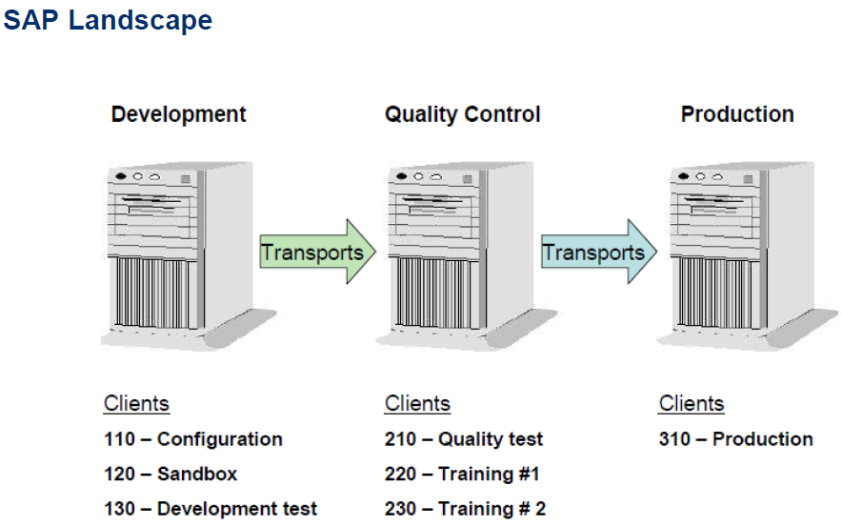
SAP Landscape

Slide 24
Why R/3
The main purpose of an R/3 system is to provide a suite of tightly integrated, large-scale business applications. The standard set of applications delivered with each R/3 system are the following:
PP (Production Planning)
MM (Materials Management)
SD (Sales and Distribution)
FI (Financial Accounting New)
CO (Controlling)
AM (Fixed Assets Management)
PS (Project System)
WF (Workflow)
IS (Industry Solutions)
HR (Human Resources)
PM (Plant Maintenance)
QM (Quality Management)
Notes:
The above applications are called the functional areas, or application areas, or at times the functional modules of R/3. All of these terms are synonymous with each other.

Slide 25
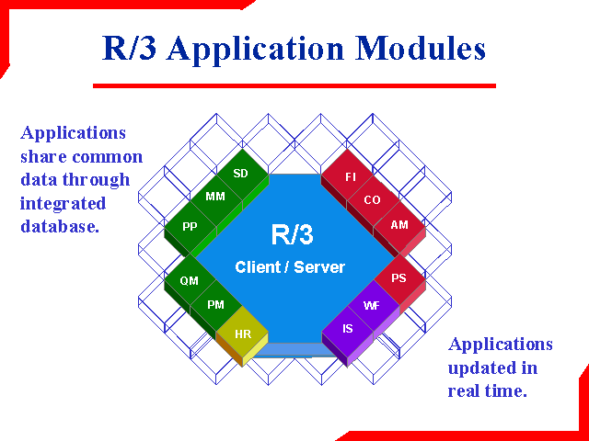
SAP Core Modules

Slide 26
Defining R/3
R/3 means Real-time 3-tier Architecture
R/3 software supports all of a company’s business transactions and links them together using real-time integration
Real-time integration means that each change or update in one application causes the automatic change or update of the data in the other applications involved.
R/3 also represents 3-tiered Client-Server Architecture.
The three Logical Layers of this R/3 Architecture are…
The Presentation Layer: Collects user input and creates process request.
The Application Layer: Uses the Application logic of Program to collect and process the process request.
The Database Layer: Stores and Retrieves all Data.

Slide 27
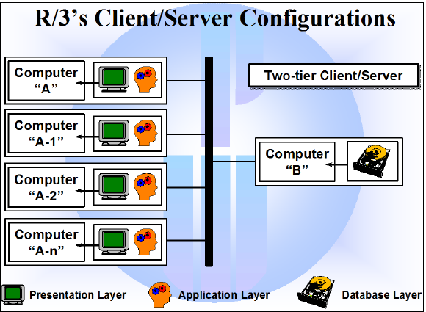
SAP R/3 Architecture
Three-tier client/server:
Presentation, application, and database layers run on separate computers.
Currently, three-tier client/server offers the best solution for most businesses.
It is highly scalable, and offers better distribution of process requests received from the users.
The computers in the application layer are often capable of satisfying the users process requests without accessing the database, which in turn boosts performance.

Slide 28
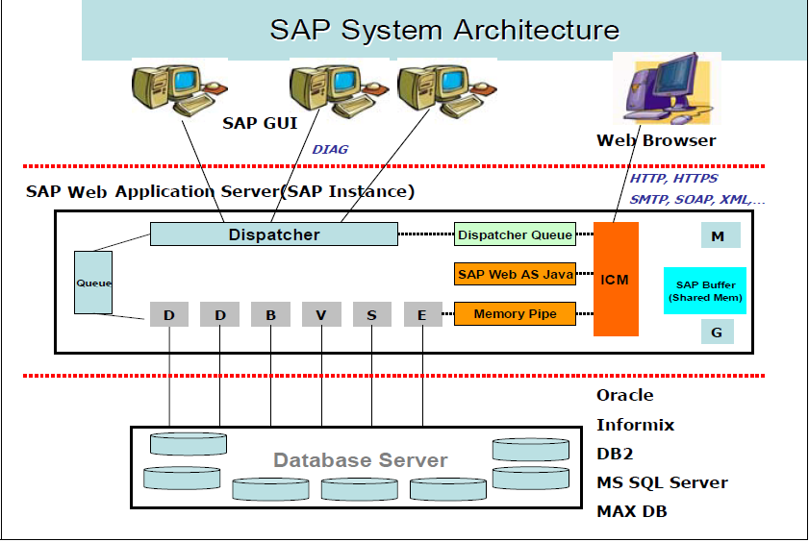
Application Server Architecture
The components of an application server are shown in the figure below. It consists of a dispatcher and multiple work processes.

Slide 29
Application Server Architecture
All requests that come in from presentation servers are directed first to dispatcher.
The dispatcher writes them first to the dispatcher queue.
The dispatcher pulls the requests from the queue on a first-in, first-out basis.
Each request is then allocated to the first available work process.
A work process handles one request at a time.
To perform any processing for a user’s request, a work process needs to address two special memory areas: the user context and the program roll area.
The user context is a memory area that contains information about the user, and the roll area is a memory area that contains information about the programs execution

Slide 30
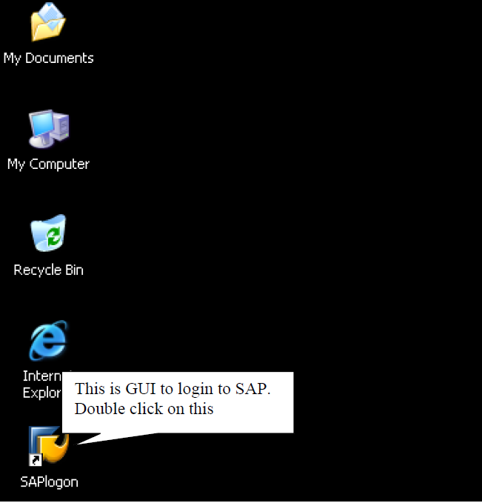
LOGIN IN TO SAP

Slide 31
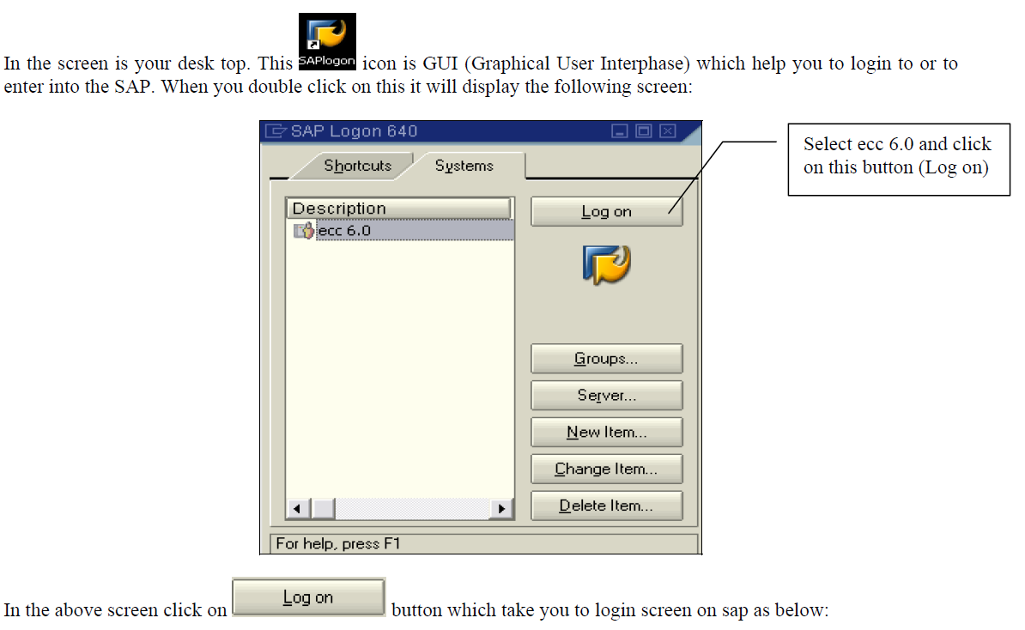
LOGIN IN TO SAP

Slide 32
SAP FI Overview
Purpose
Use
Challenges

Slide 33
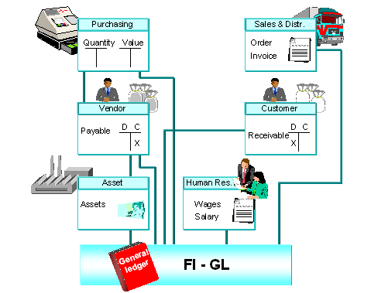
Purpose
Financial Accounting (FI) is the key building block to an organization on which most other modules depend on.
FI Organization Elements ensure that other modules work in sync with business requirements.
FI Organization Elements enable a thorough analysis of current business operations and enable planning scenarios.
FI Organization Elements are assigned to Organization Elements from other modules viz. Sales Organization in SD, Purchasing Organization in MM, Plant in Logistics, this ensures the real time integration of FI with all other modules.
The central task of G/L accounting is to provide a comprehensive picture for external accounting and accounts.
Recording all business transactions (primary postings as well as settlements from internal accounting) in a software system that is fully integrated with all the other operational areas of a company ensures that the accounting data is always complete and accurate.

Slide 34
Use
FI Organization Elements involve defining and configuring the elements which will enable an organization to:
Purchase materials from vendors (Payables Accounting).
Make sales to customers (Receivables Accounting).
Internal and External reporting of financials to stakeholders (Balance Sheet, Profit & Loss Account, Cash Flow etc).
Accounting & Control of Fixed Assets -Capitalize and depreciate (Asset management).
Make and receive payments (Treasury Management) .
Enable planning for future projects (Investment management).
Profitability & other MIS Analysis for various products, segments, cost objects (Controlling).

Slide 35
Challenges
It is the most critical decision to define the FI Organization Structure and its elements based on business process since all other modules or business functions are linked to FI and information is gathered and consolidated in FI for various reporting purposes.

Slide 36
Sub modules in FI /CO
FINANCIAL ACCOUNTING CONTROLLING
FI-GL General Ledger Accounting
FI-AR Accounts Receivable
FI-AP Accounts Payable
FI-LC Legal Consolidation
FI-SL Special Purpose Ledger
FI-AA Asset Accounting
TR - Treasury
CO-OM Overhead Cost Controlling
CO-PC Product Cost Controlling
CO-PA Sales & Profitability Analysis
CO-ABC Activity Based Costing
EC - Enterprise Controlling
EC-PCA Profit Center Accounting
EC-EIS Executive Information System
IM - Investment Management
FM-Funds Management
TR-CM Cash Management
TR-FM Funds Management
TR-TM Treasury Management
IM- FA – Tangible Fixed Assets

Slide 37


